Slide 1
How to Discern Spiritual Gifts in Yourself and Others
Dr. Rick Griffith • Amman International Church
BibleStudyDownloads.org

Slide 2
Is He Worthy?

Slide 3
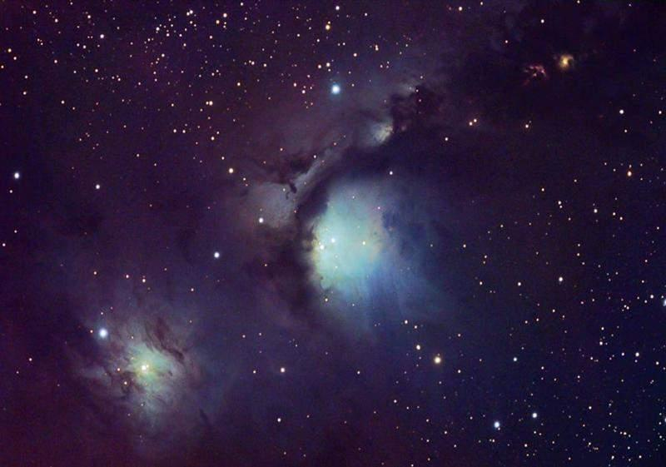
How Great Thou Art 1/10
Then sings my soul,
My Savior God, to thee:
How great thou art!
How great thou art!
Notes:
*

Slide 4
How Great Thou Art 1/10
When Christ shall come
With shout of acclamation
And take me home,
What joy shall fill my heart!
Notes:
*

Slide 5
How Great Thou Art 1/10
Then I shall bow
In humble adoration,
And there proclaim,
"My God, how great thou art!"
Notes:
*

Slide 6
How Great Thou Art 1/10
Then sings my soul,
My Savior God, to thee:
How great thou art!
How great thou art!
Notes:
*

Slide 7
How Great Thou Art 1/10
Then sings my soul,
My Savior God, to thee:
How great thou art!
How great thou art!
Notes:
*

Slide 8
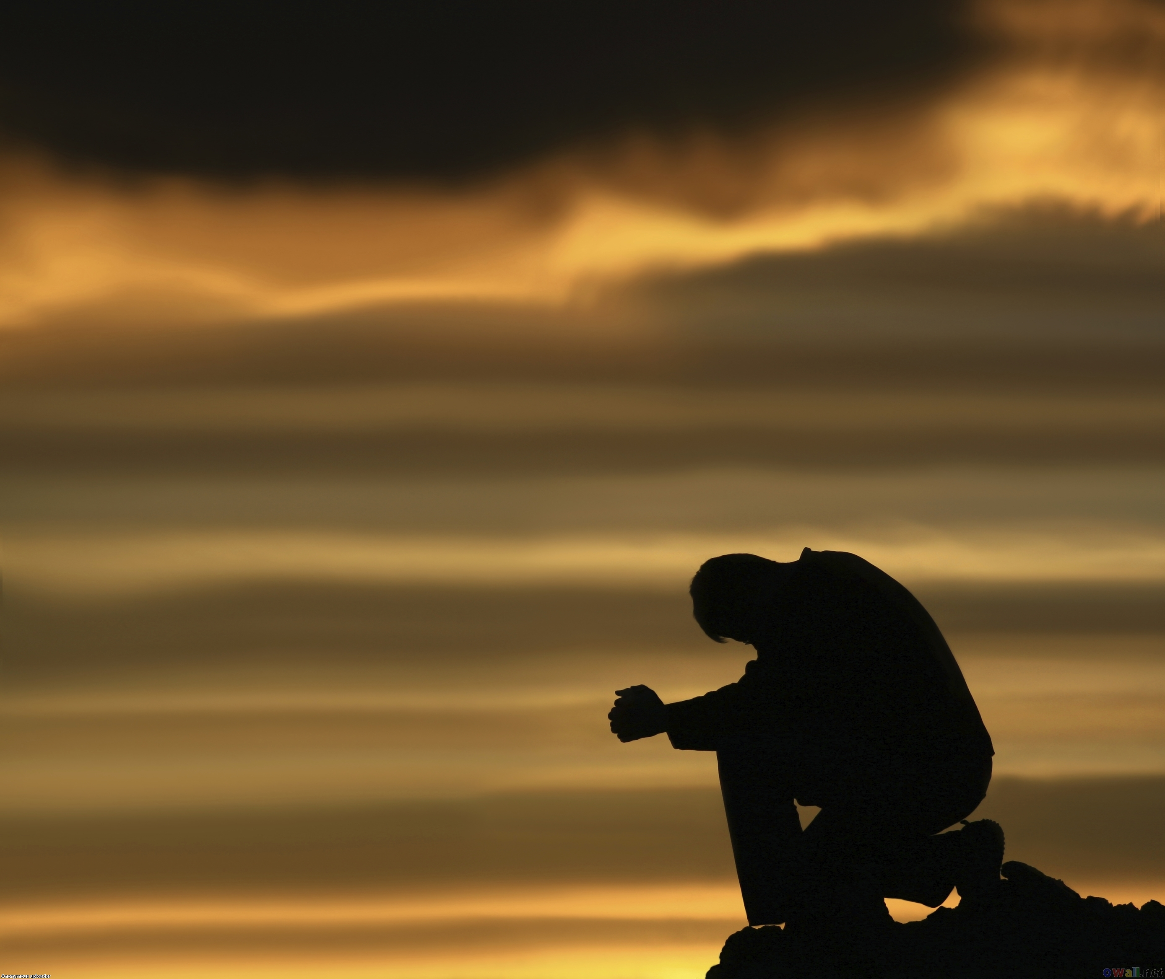
SPEAK, O LORD
Keith Getty & Stuart Townend
CCLI Song # 4615235
© 2005 Thankyou Music
CIC CCLI Licence # 277507

Slide 9
Speak, O Lord, as we come to You
To receive the food of Your holy word.
Take Your truth, plant it deep in us;
Shape and fashion us in Your likeness,

Slide 10
That the light of Christ
Might be seen today
In our acts of love
And our deeds of faith.
Speak, O Lord, and fulfill in us
All Your purposes, for Your glory.

Slide 11
Teach us Lord full obedience,
Holy reverence true humility,
Test our thoughts and our attitudes
In the radiance of Your purity.

Slide 12
Cause our faith to rise,
Cause our eyes to see,
Your majestic love and authority.
Words of power that can never fail;
Let their truth prevail over unbelief.

Slide 13
Speak, O Lord, and renew our minds;
Help us grasp
The heights of Your plans for us.
Truths unchanged
From the dawn of time,
That will echo down through eternity.

Slide 14
And by grace
We'll stand on Your promises;
And by faith we'll walk
As You walk with us.
Speak, O Lord, till Your church is built
And the earth is filled with Your glory.

Slide 15
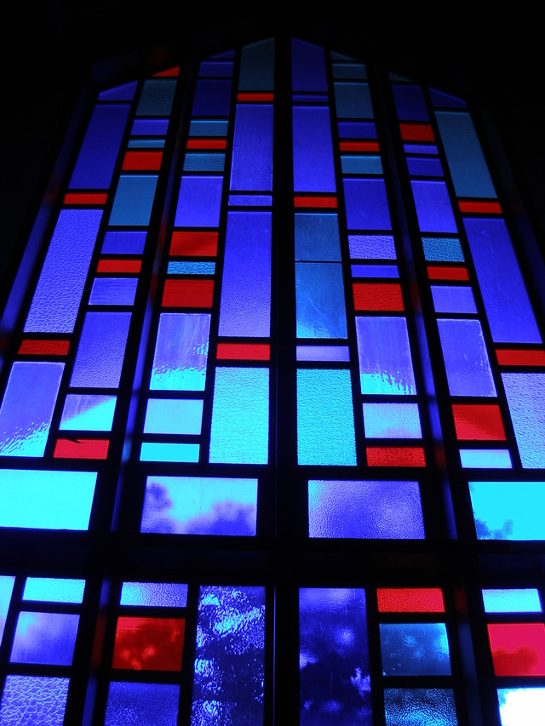
What Should Churches Aim For?
Numerical church growth is not a NT emphasis
(1 Cor. 4:2)

Slide 16
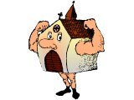
Scriptural Marks of a Healthy Church
Healthy churches...
are measured in spiritual rather than numerical terms
follow biblical rather than cultural patterns of ministry
are based on theological rather than sociological foundations
Kenneth O. Gangel, “Marks of a Healthy Church,” Bibliotheca Sacra 158 (October-December 2001): 467-77

Slide 17
Scriptural Marks of a Healthy Church
Healthy churches...
focus on a ministry model rather than a marketing model
adopt scriptural rather than secular models of leadership
Kenneth O. Gangel, “Marks of a Healthy Church,” Bibliotheca Sacra 158 (October-December 2001): 467-77

Slide 18
Inventories Can Sometimes Help Us Discern Our Gifts

Slide 19
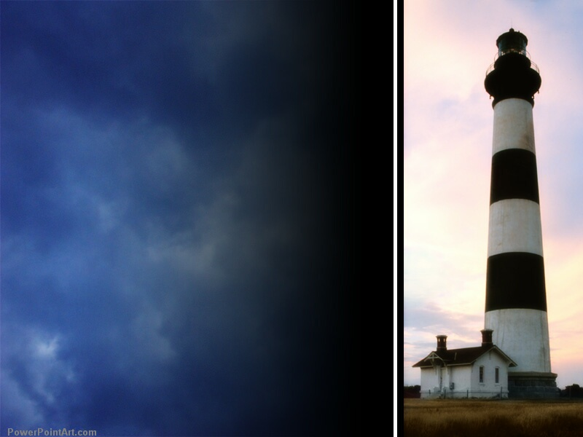
How can you know what gift God gave you?

Slide 20
How to Discern Your Spiritual Gifts
Salvation
65
Spirit-Filling
Spirit-Walking
See Self-Significance
Submission
Supplication
Study
Skill
Self-Correction
Self-Analysis
Satisfaction
Seek Suggestions
Selection
Strike Out
Service
Success
Switch
Surrender
Stay

Slide 21
Small Group Discussion Questions
62
What did the inventory show as your gift(s)? Did you score higher in speaking or serving gifts?
Do you agree with the inventory results? Do the others in your group agree?
What commitment will you make to the Lord to develop your gift(s)? Be specific concerning where and how you think it can be used. Share this with your group.

Slide 22
Categories of Gifts (1 Peter 4:11)
Get
words from God
Get
strength from God
47
Speaking | Serving
Teaching | Administering
Evangelism | Faith
Pastor-Teacher | Giving
Encouraging | Service
 | Mercy
Notes:
22

Slide 23
Spiritual Gifts Class Record
63
 | Teach | Evan | Pastor | Exhort | Admin | Faith | Giving | Service | Mercy
Rick Griffith | 1 | 6 | 2 | 3 | 2 | 8 | 4 | 5 | 7
Susan Griffith | 1 | 6 | 3 | 3 | 6 | 4 | 5 | 1 | 2
David Martin | 1 | 4 | 3 | 2 | 7 | 8 | 6 | 5 | 9
Lois Martin
Serum
Troy Josey | 3 | 8 | 4 | 1 | 6 | 7 | 9 | 5 | 2
Kristen Josey | 2 | 7 | 3 | 4 | 1 | 8 | 6 | 7 | 5
Seth Rogers | 4 | 9 | 8 | 1 | 6 | 2 | 2 | 7 | 5
Lydia Rogers | 5 | 9 | 6 | 3 | 4 | 7 | 8 | 1 | 2
Hans van der Zwan | 1 | 9 | 2 | 8 | 2 | 5 | 7 | 5 | 4
Johanna van der Zwan | 1 | 8 | 4 | 5 | 3 | 9 | 7 | 2 | 6
1st Scores of 1 | 5 | 0 | 0 | 2 | 1 | 0 | 0 | 2 | 0

Slide 24
Spiritual Gifts Class Record
63
 | Teach | Evan | Pastor | Exhort | Admin | Faith | Giving | Service | Mercy
Liu (Adrian) | 1 | 3 | 6 | 2 | 3 | 4 | 5 | 3 | 3
Christine Sabando | 3 | 3 | 5 | 2 | 3 | 4 | 1 | 5 | 6
Airlyn Villegas | 7 | 6 | 3 | 4 | 6 | 1 | 5 | 4 | 2
Brent Marion | 1 | 2 | 5/6 | 7 | 3 | 4 | 8 | 5/6 | 9
Mary Marion | 7 | 8 | 3 | 6 | 9 | 4 | 5 | 1 | 2
Bryan Ryker | 3 | 1 | 6 | 7 | 2 | 9 | 8 | 4 | 5
Christy Ryker | 7 | 8 | 3 | 4 | 5 | 2 | 1 | 9 | 6
David Harakal | 2 | 7 | 3 | 5 | 1 | 6 | 5 | 4 | 8
Suzanne Harakal | 8 | 7 | 2 | 3 | 9 | 4 | 6 | 5 | 1
Deepa Wilson | 2 | 7 | 1 | 4 | 5 | 6 | 8 | 5 | 3
Hannah Wilson | 2 | 9 | 6 | 1 | 4 | 7 | 8 | 5 | 3
2nd Scores of 1 | 2 | 1 | 1 | 1 | 1 | 1 | 2 | 1 | 1

Slide 25
Spiritual Gifts Class Record
63
 | Teach | Evan | Pastor | Exhort | Admin | Faith | Giving | Service | Mercy
Abu Walid | 6 | 3 | 2 | 4 | 5 | 1 | 1 | 3 | 2
Dan Bridges | 1 | 5 | 3 | 4 | 2 | 7 | 5 | 7 | 6
Lisa Bridges | 5 | 9 | 3 | 4 | 8 | 7 | 6 | 2 | 1
Sarah Bridges | 6 | 6 | 5 | 8 | 2 | 4 | 7 | 3 | 1
Hannah Bridges | 6 | 6 | 3 | 4 | 5 | 8 | 7 | 2 | 1
Remko Veenstra | 9 | 8 | 6 | 7 | 1 | 4 | 3 | 2 | 5
Eline Veenstra | 5 | 8 | 4 | 6 | 1 | 6 | 7 | 2 | 3
Jamal | 6 | 1 | 3 | 5 | 5 | 8 | 7 | 4 | 2
Shireen | 6 | 8 | 7 | 3 | 1 | 4 | 5 | 2 | 3
Gabriella | 4 | 6 | 9 | 9 | 2 | 9 | 6 | 3 | 1
Isabel | 6 | 7 | 5 | 5 | 1 | 8 | 9 | 3 | 3
1st Scores of 1 | 5 | 0 | 0 | 2 | 1 | 0 | 1 | 2 | 0
2nd Scores of 1 | 2 | 1 | 1 | 1 | 1 | 1 | 2 | 1 | 1
3rd Scores of 1 | 1 | 1 | 0 | 0 | 4 | 0 | 1 | 0 | 4
Total Scores of 1 | 8 | 2 | 1 | 3 | 6 | 1 | 3 | 3 | 5

Slide 26
Spiritual Gifts Class Record
63
 | Teach | Evan | Pastor | Exhort | Admin | Faith | Giving | Service | Mercy
Mark Szymecki
Christine Szymecki
Margaret Rogers
Chris Carley
Katie Carley
Muhannad Fakhouri
Ampy Fakhouri
Yo & Misa
Omar Vazquez
Joy Vazquez
1st Scores of 1 | 5 | 0 | 0 | 2 | 1 | 0 | 0 | 2 | 0
2nd Scores of 1 | 2 | 1 | 1 | 1 | 1 | 1 | 2 | 1 | 1
3rd Scores of 1 | 1 | 1 | 0 | 0 | 4 | 0 | 0 | 0 | 4
Total Scores of 1 | 8 | 2 | 1 | 3 | 6 | 1 | 2 | 3 | 5

Slide 27
There's a reason they're called “gifts”…

Slide 28
Can a Christian receive more than one gift?

Slide 29
Two Views on Giftedness
44
Christians Have Only One Gift
Christians Can Have Many Gifts
“Gift” singular
Body part
Concentrate
“Gift” = “A”
Symbols
NIV
NT examples

Slide 30
Speaking Gifts Contrasted
47
 | Teaching | Evangelism | Pastor-Teacher | Exhortation
Shares | Biblical Learning | Faith & Testimony | Heart & Bible | Optimism
Recipient Need Met | Scriptural Truth | Salvation & Equipping for Evangelism | Shepherding | Encouragement
Sensitive to Needs | Doctrinally | For Conversion | Spiritually (overall needs) | Spiritually (specific needs)
Ministers to Those Needing | Instruction | Saving Faith | General Spiritual Direction | Urging in Practical Steps
General Trait | Accuracy in the Word | Heart for the Lost | Shepherd Heart | Uplifts Others

Slide 31
Serving Gifts Contrasted
54
 | Adminis- trations | Faith | Giving | Service | Showing Mercy
Shares | Organizing Ability | Vision | Possessions | Abilities | Concern
Recipient Need Met | Leadership | Belief | Monetary | Assistance | Understand-ing
Sensitive to Needs | Managerially | Visually | Materially | Practically | Emotionally
Ministers to Those Needing | Structure | Hope | Finances & Material Things | Aid in Everyday Tasks | Comfort
General Trait | Orderliness | Confi-dence in God | Generosity | Availability | Compassion

Slide 32
There is no one like you!
"If you’re just like someone else, we don’t need you."
–– Dr. Howard Hendricks (1924-2013)

Slide 33
Black

Slide 34
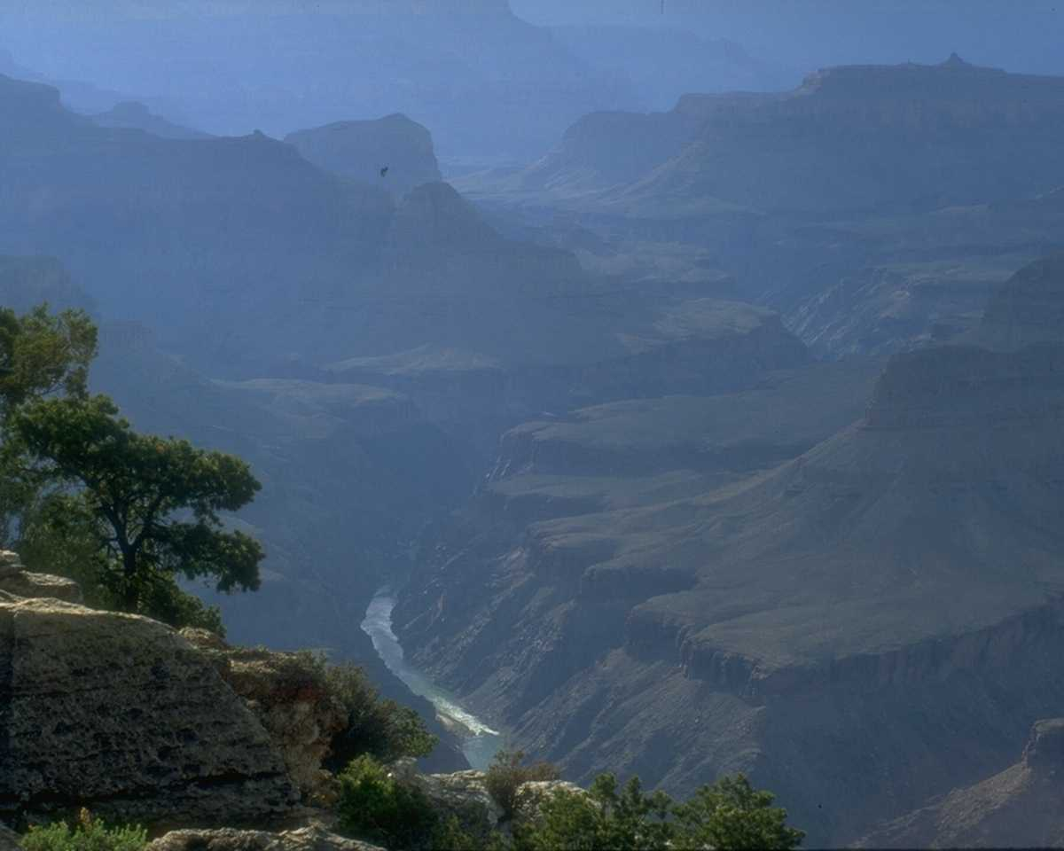
Seekers of Your Heart
CCLI Song # 10635
Beverly Darnall | Dick Tunney | Melodie Tunney
© 1985 Universal Music - Brentwood Benson Publishing (Admin. by Brentwood-Benson Music Publishing, Inc.)
Pamela Kay Music (Admin. by Capitol CMG Publishing)
For use solely with the SongSelect® Terms of Use. All rights reserved. www.ccli.com
CCLI License # 277507

Slide 35
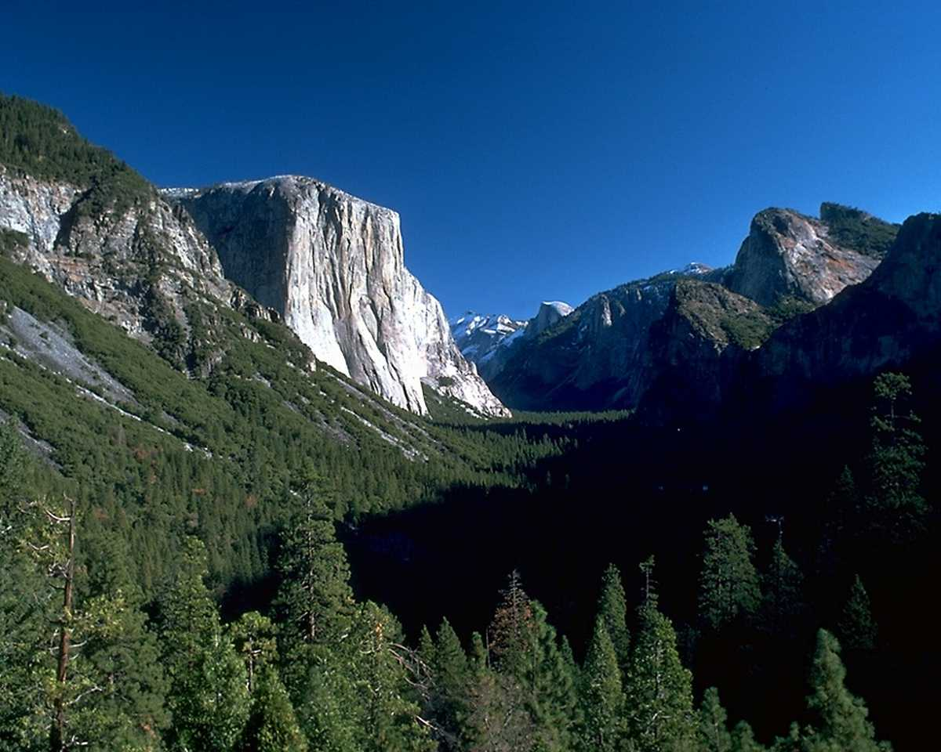
Until we give you first place,
until we let you begin
to fill us with your Spirit,
renew us from within.
Nothing matters, nothing’s gained;
without your holy presence
our lives are lived in vain.

Slide 36
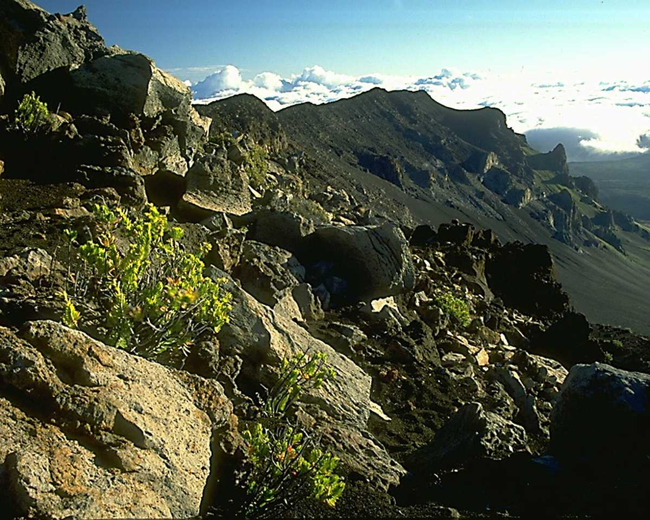
Lord, we want to know you,
live our lives to show you
all the love we owe you;
we’re seekers of your heart.

Slide 37
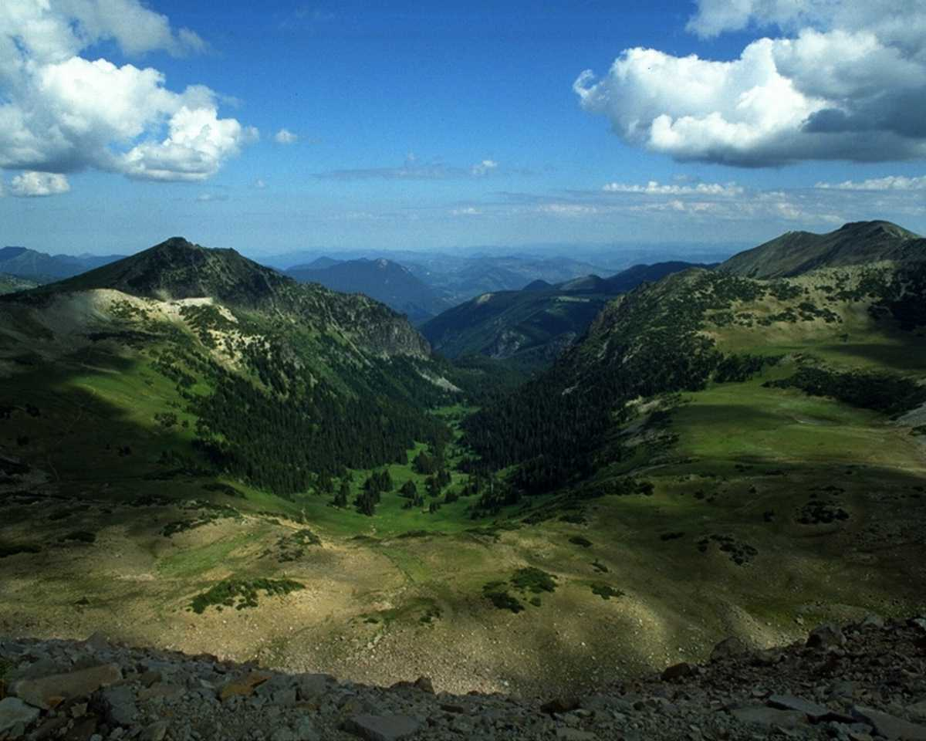
Because your heart was broken,
because you saw the need,
because you gave so freely,
because of Calvary
we can now be called your own;
complete creations
filled with you alone.

Slide 38
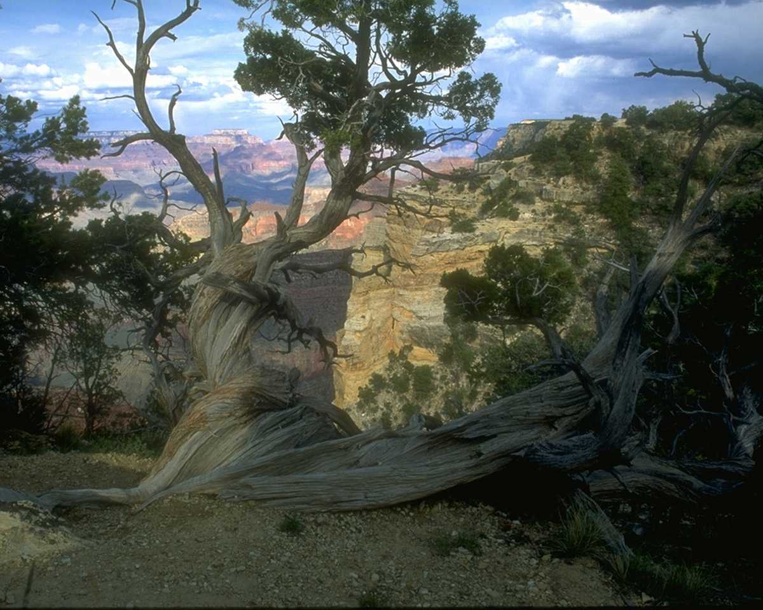
Lord, we want to know you,
live our lives to show you
all the love we owe you;
we’re seekers of your heart.

Slide 39
Lord, we want to know you,
live our lives to show you
all the love we owe you;
we’re seekers of your heart.

Slide 40
Spiritual Gifts Class Record
63
 | Teach | Evan | Pastor | Exhort | Admin | Faith | Giving | Service | Mercy
Rick | 1 | 6 | 2 | 3 | 2 | 8 | 4 | 5 | 7
Cassandra | - | - | - | - | - | - | - | - | -
Eve | 1 | 2 | 3 | 5 | 6 | 7 | 7 | 8 | 4
Hannah | 1 | 9 | 8 | 7 | 6 | 3 | 2 | 4 | 5
Genevieve | 1 | 7 | 8 | 5 | 2 | 4 | 4 | 3 | 6
Joen Yen | 1 | 5 | 3 | 3 | 2 | 9 | 8 | 7 | 5
Swee Guan | 4 | 6 | 3 | 5 | 2 | 1 | 9 | 7 | 8
Isaac | 4 | 5 | 8 | 6 | 7 | 2 | 3 | 6 | 1
Jason | 6 | 2 | 3 | 2 | 1 | 2 | 5 | 3 | 4
Jessica | 1 | 7 | 7 | 6 | 3 | 4 | 2 | 5 | 8
Desmond | 1 | 9 | 6 | 8 | 4 | 7 | 5 | 2 | 3
Wee Seong | 1 | 2 | 5 | 6 | 3 | 7 | 8 | 4 | 8
Siew Kuan | 9 | 8 | 6 | 7 | 2 | 3 | 1 | 4 | 5
Moses | 1 | 5 | 2 | 3 | 2 | 3 | 2 | 4 | 6
Mimi | 1 | 4 | 3 | 6 | 8 | 7 | 5 | 4 | 2
Xena Wendy | 3 | 6 | 1 | 2 | 3 | 5 | 8 | 7 | 7
Total Scores of 1 | 9 | 0 | 1 | 0 | 1 | 1 | 1 | 0 | 1

Slide 41
Spiritual Gifts Class Record
63
 | Teach | Evan | Pastor | Exhort | Admin | Faith | Giving | Service | Mercy
Rick Griffith | 1 | 6 | 2 | 3 | 2 | 8 | 4 | 5 | 7
1 Char Ley | 5 | 2 | 6 | 4 | 7 | 8 | 3 | 4 | 1
2 Cheng Kiat | 1 | 4 | 3 | 3 | 2 | 6 | 7 | 8 | 5
3 Djenny | 2 | 8 | 5 | 3 | 1 | 7 | 5 | 6 | 4
4 Chay Giam | 1 | 4 | 3 | 2 | 4 | 3 | 6 | 5 | 4
5 Roy 30-39 | 1 | 2 | 1 | 4 | 5 | 4 | 5 | 3 | 2
6 Jim | 4 | 9 | 2 | 5 | 3 | 8 | 6 | 7 | 1
7 Casurine | 4 | 3 | 5 | 5 | 4 | 7 | 6 | 2 | 1
8 Rene | 2 | 7 | 4 | 6 | 2 | 1 | 4 | 5 | 3
9 No Htoo | 2 | 1 | 3 | 5 | 4 | 6 | 6 | 5 | 7
10 Sokheang | 1 | 3 | 2 | 5 | 7 | 4 | 3 | 4 | 3
11 Tom | 1 | 9 | 2 | 6 | 8 | 7 | 5 | 3 | 4
12 Vanna | 2 | 8 | 7 | 4 | 6 | 1 | 3 | 3 | 5
13 Jin Ju | 6 | 4 | 1 | 3 | 4 | 1 | 7 | 5 | 2
14 Babychen | 4 | 6 | 2 | 2 | 1 | 2 | 5 | 4 | 3
Totals | 5 | 1 | 2 | 0 | 2 | 2 | 0 | 0 | 3

Slide 42
Spiritual Gifts Class Record - Grads
63
 | Teach | Evan | Pastor | Exhort | Admin | Faith | Giving | Service | Mercy
Rick Griffith | 1 | 6 | 2 | 3 | 2 | 8 | 4 | 5 | 7
Loo, James | 1 | 2 | 5 | 4 | 3 | 4 | 6 | 8 | 7
Ong Geok Wah | 1 | 3 | 2 | 3 | 3 | 3 | 4 | 5 | 2
Chang, Deborah | 2 | 7 | 4 | 3 | 5 | 6 | 3 | 3 | 1
Ho, Ivan | 1 | 7 | 3 | 2 | 5 | 9 | 8 | 6 | 4
Lo, Matthew | 7 | 8 | 3 | 5 | 1 | 6 | 9 | 2 | 4
Say, Simon | 1 | 4 | 2 | 3 | 3 | 6 | 3 | 7 | 5
Chandra, Elisabeth | 1 | 7 | 2 | 4 | 5 | 6 | 8 | 5 | 3
Sun, Lora May | 1 | 3 | 7 | 6 | 4 | 6 | 5 | 2 | 4
Tran, Thuy | 1 | 6 | 2 | 4 | 6 | 7 | 8 | 5 | 3
Low, Penny | 5 | 8 | 4 | 3 | 1 | 6 | 7 | 3 | 2
Gombojav, Tumen | 1 | 4 | 6 | 6 | 2 | 5 | 3 | 8 | 7
Han, James | 1 | 5 | 5 | 7 | 4 | 2 | 3 | 9 | 8
Ling Ing Lung, Eric | 1 | 7 | 5 | 5 | 4 | 6 | 2 | 2 | 3
Tan, Kenneth | 1 | 5 | 2 | 4 | 7 | 3 | 9 | 6 | 8
Nanghee, Syndang | 1 | 8 | 3 | 6 | 4 | 7 | 5 | 5 | 2
Wong, Karsun | 1 | 8 | 2 | 3 | 6 | 7 | 5 | 4 | 2
Total Slide 1 | 13 | 0 | 0 | 0 | 2 | 0 | 0 | 0 | 1

Slide 43
Spiritual Gifts Class Record - Bachelor
63
 | Teach | Evan | Pastor | Exhort | Admin | Faith | Giving | Service | Mercy
Rick Griffith | 1 | 6 | 2 | 3 | 2 | 8 | 4 | 5 | 7
Chumbeni | 4 | 6 | 4 | 5 | 3 | 4 | 3 | 1 | 2
Moe Ka Fat | 1 | 7 | 4 | 3 | 3 | 8 | 6 | 5 | 2
Joni Siau | 4 | 5 | 4 | 4 | 3 | 2 | 4 | 1 | 6
Joshua Rungsung | 1 | 2 | 4 | 4 | 3 | 2 | 3 | 5 | 6
Karl Fritz | 1 | 4 | 4 | 6 | 8 | 7 | 5 | 2 | 3
Maya Perera | 2 | 3 | 2 | 1 | 1 | 2 | 5 | 6 | 4
Jacob Ang | 4 | 6 | 2 | 3 | 5 | 7 | 8 | 5 | 1
Michael Mohgan | 1 | 7 | 6 | 7 | 3 | 5 | 4 | 3 | 2
William Siew | 2 | 7 | 5 | 2 | 1 | 3 | 6 | 8 | 4
David Ravi | 2 | 6 | 3 | 4 | 5 | 6 | 6 | 1 | 2
Total Slide 1 | 13 | 0 | 0 | 0 | 2 | 0 | 0 | 0 | 1
Total Slide 2 | 4 | 0 | 0 | 1 | 2 | 0 | 0 | 2 | 1
Grand Total | 17 | 0 | 0 | 1 | 4 | 0 | 0 | 2 | 2

Slide 44
Crossroads Spiritual Gifts Results
63
 | Teach | Evan | Pastor | Exhort | Admin | Faith | Giving | Service | Mercy
Rick | 1 | 7 | 2 | 4 | 2 | 9 | 5 | 6 | 8
Susan | 2 | 9 | 4 | 5 | 8 | 6 | 7 | 1 | 3
Lewis | 1 | 5 | 3 | 2 | 3 | 8 | 7 | 5 | 8
Barbara | 3 | 1 | 4 | 5 | 8 | 7 | 6 | 9 | 2
Leland | 3 | 9 | 8 | 7 | 6 | 5 | 1 | 4 | 2
Linda Calhoun | 8 | 9 | 4 | 5 | 2 | 7 | 6 | 1 | 3
Andrew | 5 | 8 | 5 | 3 | 2 | 8 | 7 | 1 | 4
Adrielle | 5 | 9 | 4 | 6 | 8 | 7 | 2 | 3 | 1
Valentin | 3 | 9 | 5 | 5 | 2 | 8 | 7 | 1 | 4
Jieun | 8 | 7 | 9 | 6 | 5 | 2 | 3 | 1 | 4
Bal | 8 | 9 | 3 | 6 | 1 | 7 | 4 | 5 | 2
Carol | 6 | 4 | 1 | 1 | 5 | 9 | 8 | 7 | 3
Drew | 1 | 3 | 5 | 7 | 7 | 6 | 2 | 4 | 9
Linda Fones | 7 | 9 | 5 | 6 | 1 | 3 | 8 | 2 | 4
Robert | 6 | 4 | 1 | 6 | 2 | 4 | 9 | 8 | 2
Geeta | 1 | 2 | 4 | 7 | 8 | 8 | 6 | 3 | 5
Net Scores of 1 | 4 | 1 | 2 | 1 | 2 | 0 | 1 | 5 | 1

Slide 45
Crossroads Spiritual Gifts Results
63
 | Teach | Evan | Pastor | Exhort | Admin | Faith | Giving | Service | Mercy
Singpu | 2 | 1 | 3 | 8 | 4 | 7 | 5 | 9 | 6
Kim | 5 | 7 | 4 | 5 | 9 | 8 | 3 | 2 | 1
Athan | 1 | 3 | 5 | 7 | 2 | 5 | 9 | 4 | 8
Chanchan | 4 | 9 | 8 | 7 | 5 | 6 | 2 | 1 | 3
Albina | 1 | 1 | 5 | 3 | 6 | 9 | 8 | 7 | 3
Désirée | 1 | 3 | 2 | 4 | 6 | 7 | 8 | 9 | 5
Jonathan | 5 | 4 | 2 | 3 | 6 | 7 | 9 | 7 | 1
Eva | 6 | 9 | 7 | 3 | 1 | 3 | 3 | 2 | 7
Deborah | 3 | 8 | 3 | 4 | 1 | 9 | 3 | 2 | 3
Miriam | 7 | 8 | 2 | 3 | 1 | 5 | 4 | 5 | 8
Shannah | 6 | 7 | 3 | 2 | 6 | 7 | 7 | 3 | 1
Tessa | 7 | 6 | 1 | 1 | 9 | 8 | 5 | 1 | 4
Sean | 6 | 6 | 8 | 9 | 1 | 5 | 2 | 4 | 2
Arun | 9 | 8 | 6 | 5 | 7 | 2 | 3 | 4 | 1
Net Scores of 1 | 3 | 2 | 1 | 1 | 4 | 0 | 0 | 2 | 4
First Slide | 4 | 1 | 2 | 1 | 2 | 0 | 1 | 5 | 1
Total Scores of 1 | 7 | 3 | 3 | 2 | 6 | 0 | 1 | 7 | 5

Slide 46
Spiritual Gifts Class Record
63
 | Teach | Evan | Pastor | Exhort | Admin | Faith | Giving | Service | Mercy
Rick | 1 | 6 | 2 | 3 | 2 | 8 | 4 | 5 | 7
Total Scores of 1 | 0 | 0 | 0 | 0 | 0 | 0 | 0 | 0 | 0

Slide 47
Holy Spirit PPT link at BibleStudyDownloads.org
Get this presentation for free!

Slide 48
Black

